Slide 1

MODULE D
Group 1 — Settling In & Belonging | A Level and Year 2 — Media, Film, Photography and Digital
Students' Voice
& Student Rep
Elections
You've had a year of this department. Now decide what you do with what you know.
100 minutes
L3 Year 2 / A-level Year 2
PROUD value: Encourage Unity | Eastbourne · Lewes · Hastings (Station Plaza)
Notes:
SLIDE 1 — TITLE
Mode: TEACHER INPUT | Variant: L3 Year 2 / A-level Year 2
Do not use this deck with new starters. This variant is calibrated for students who have been at ESCG for at least one year.
The subtitle — 'You know how this works. Now decide what you do with that.' — sets the register. This isn't induction. It's a check-in and a decision point.
Two subgroups to hold in mind:
L3 Year 2: Last year of their Level 3. Don't fumble the last lap. They have enough institutional knowledge to stand for Rep or Governor with genuine credibility.
A-level Year 2: UCAS is live or imminent. Time is finite. Rep role is still real and worth taking on; Governor election in November is less relevant (most will have left before they could serve a full term — flag this in speaker notes context on slide 7).
PROUD value: Encourage Unity. The returner framing: 'You've seen collective voice work or not work. You're the ones who know how to make it work this year.'
DEPARTMENT VERSION — this deck has been personalised for A Level and Level 3 Year 2 Media, Film, Photography and Digital (Media A Level at Eastbourne and Lewes, Media Studies A Level at Station Plaza, Film Studies at Lewes and Hastings, Photography A Level at Lewes, plus Year 2 Level 3 and T Level groups). Five things still need your local detail: campus and teaching group, the GCSE English and maths class times and teachers, where the Governor application link lives, who holds the Student Rep Register for your area, and one real example of something that changed here because students asked.
NEW THIS YEAR: this group elects TWO reps — one for their subject group, and one for their GCSE English or maths class. Both go on the central Student Rep Register today.

Slide 2







What we're doing today
SESSION MAP
About 100 minutes — the shape of the session
1
2
3
4
Check in
Students' Voice
Ways to get involved
The Rep role
What did Students' Voice actually achieve? (10 mins)
What makes it work — and what doesn't (10 mins)
You know the options — which one now? (10 mins)
What it takes in Year 2 (10 mins)
5
6
7
8
The Governor role
Encourage Unity
Election
Close
The Board, the commitment, how to apply (15 mins)
PROUD value anchor (5 mins)
Nominations, pitches, vote — subject rep + English/maths rep (30–35 mins)
Your rep, what's next
Module D — Students' Voice & Student Rep Elections | A Level / Year 2 — Media, Film, Photography and Digital
Notes:
SLIDE 2 — SESSION MAP
Mode: SESSION MAP | Time: 1 min
Returners don't need a detailed walkthrough — they know the format. Keep this to 30 seconds.
The one thing to flag: 'Today ends with an election. Whether or not you want to stand, pay attention to the earlier slides — you know what makes a good rep better than first-years do.'
NOTE — two seats are filled in the election slot: the subject rep and the GCSE English/maths rep. Flag it here so returners know the election is not a repeat of last year's.

Slide 3
Check in
DISCUSSION
Paired discussion — 10 minutes
What did your rep actually do last year — about deadlines, kit, or how long feedback took to come back?
What would you want raised this year — coursework deadlines against UCAS, or access to edit suites, studios and the darkroom?
Talk to the person next to you — 3 minutes, then we'll hear a few thoughts from the room.
Module D — Students' Voice & Student Rep Elections | A Level / Year 2 — Media, Film, Photography and Digital
Notes:
SLIDE 3 — CHECK IN
Mode: DISCUSSION | Time: 10 mins
Two questions, not one. The first is analytical — what actually happened? The second is forward-looking — what would you want to be different? Together they establish that this group has the experience to make the election today meaningful.
Running it: 3 minutes paired, then invite 4–5 responses. Don't editorialise — note the themes briefly. The punchline: 'You've just described what a good rep looks like. Keep that in mind when you're voting — or standing — later.'
What to watch for: students who say 'I never knew who our rep was' or 'they never fed back.' These are valid critiques. Acknowledge them directly — 'That's exactly the gap this year's election can fix.' Don't get defensive.
L3Y2 specific: some may be genuinely energised by the start of a new year. Others may be coasting. The two-question format tends to surface both.
A-level Y2 specific: UCAS pressure may be visible already. Acknowledge at close of discussion if relevant: 'I know some of you are already deep into applications. That's exactly why having a rep who understands the pressure you're under matters.'
Safeguarding: open questions occasionally surface concerns. Listen calmly, do not promise confidentiality, report same day. Module F covers full procedure.
NOTE — both check-in questions now name this department's realities: deadlines and feedback turnaround, coursework against UCAS, and access to edit suites, studios and the darkroom. Returners answer a generic question generically; a question about their own subject produces the specific, evidenced feedback slide 4 then asks them to recognise as effective.

Slide 4


Students' Voice — what makes it work
TEACHER INPUT
You've seen a year of it. Here's the honest picture.
When it works
Teaching & Learning
Student experience
Reps who actually consult their group — not just improvise at meetings
Feedback that names the thing — “coursework feedback arrives too late to act on” beats “feedback is bad”
Groups who tell their rep what matters — before the meeting, not after
Students who follow up — checking the past papers appeared, or the darkroom hours actually changed
Curriculum and delivery shaped by what students report — how coursework and exam preparation are sequenced across Year 2
Campus life improved by evidenced feedback — studio, darkroom and edit-suite access outside lessons
Community
Visible outcomes
Staff and students agreeing what “exam-ready” means, and by when
You can see what changed — and what's still being worked on
Collective voice is a shared responsibility — not just the rep's job
Module D — Students' Voice & Student Rep Elections | A Level / Year 2 — Media, Film, Photography and Digital
Notes:
SLIDE 4 — STUDENTS' VOICE Mode: TEACHER INPUT | Time: 10 mins Purpose: move the conversation from 'what is this' (which returners already know) to 'what makes it actually work.' This is a more sophisticated framing than Core's introductory slide. The left panel names the four conditions for effectiveness. Each one is worth a sentence — draw on what the check-in discussion surfaced. If the group said their rep 'never fed back,' that maps directly to the third bullet ('groups who tell their rep what matters'). The honest case: 'Students' Voice doesn't work automatically. It works when the rep is genuinely plugged in, and when the group uses them. Both sides of that have to function.' Don't over-promise outcomes — returners will call it out if you do. The 'visible outcomes' card is the important one: outcomes are documented and visible, even when they're partial or slow. Bridge: 'So — knowing all that — let's look at the roles available and which one might suit where you are this year.'

Slide 5
Ways to get involved
TEACHER INPUT
You know the options — which one fits Year 2?
Student Rep
Two elected today
Student Governor
Apply by 16 Oct
Elected today. You know what the role involves — and what it looks like when it’s done well. You also elect a rep for your GCSE English or maths class.
3 places on the Main Governing Board — where equipment, technician capacity and studio provision get decided. Applications close midday, Friday 16 October — see slides 7–10.
NUS Membership
You're already in
Surveys & Forums
From 3 Nov
You're already a member. TOTUM card (£14.99/year) gives discounts across hundreds of retailers — worth checking before you buy set texts, materials or travel to open days.
Induction Survey opens 3 November. Three minutes — the place to say if coursework deadlines and UCAS are colliding.
Module D — Students' Voice & Student Rep Elections | A Level / Year 2 — Media, Film, Photography and Digital
Notes:
SLIDE 5 — WAYS TO GET INVOLVED
Mode: TEACHER INPUT | Time: 10 mins
Returners don't need each option explained from scratch. The framing question — 'which one fits Year 2?' — is the right lens.
Student Rep: 'You've seen what a rep does, and you probably have views on what makes a good one. That knowledge is exactly what makes you a stronger candidate than you were last year.'
Student Governor: note the forward flag — 'requires commitment beyond this year.' A-level Y2 students who are leaving after this year are not eligible to serve a full Governor term. Flag this without making it a barrier: 'If you're continuing at ESCG, this is worth looking at seriously in November.'
Induction Survey: 'Three minutes, and it's how the college gets a picture of what Year 2 actually looks like from the inside. Worth doing even if you do nothing else today.'
NOTE — the Student Rep card now names both seats. For students who resit GCSE English or maths, that class is often where they feel least represented; say plainly that it now has a rep of its own.

Slide 6

The Student Representative role
TEACHER INPUT
Year 2: familiarity is an advantage — if you use it
What reps do
Student Council meetings 26/27
Gather and convey student opinions to college leadership
Attend 3 Student Council meetings per year (dates on the right)
Provide feedback on teaching, and on studio, darkroom and edit-suite access
Work with staff to develop solutions — not just present problems
Keep the group informed after every meeting
Represent this group in your GCSE English or maths class as well as your subject
Campus | Council 1 | Council 2 | Council 3
Eastbourne | Wed 11 Nov | Mon 15 Mar | Wed 5 May
Lewes | Tue 10 Nov | Wed 17 Mar | Wed 5 May
Station Plaza | Thu 12 Nov | Mon 15 Mar | Tue 4 May
Ore Valley & ATIC | Tue 10 Nov | Wed 17 Mar | Wed 5 May
Rep training: Wednesday 14 October (all campuses)
Year 2 advantage: you know the staff, the meetings, and what actually moves things.
Even if you've done training before, attendance is expected for newly elected reps. Flag it now if 14 October clashes with a shoot, a study day or a coursework deadline.
Develops: communication, leadership, problem-solving, and employability skills
Module D — Students' Voice & Student Rep Elections | A Level / Year 2 — Media, Film, Photography and Digital
Notes:
SLIDE 6 — THE STUDENT REP ROLE
Mode: TEACHER INPUT | Time: 10 mins
The returner-specific framing is in the green tinted strip: 'Year 2 advantage — you know the staff, the meetings, and what actually moves things.' Say this directly.
Familiarity-as-risk is the thing to name honestly: 'The risk in Year 2 is that you know the system well enough to go through the motions. A rep who's coasting doesn't help anyone.' Pair it immediately with the positive: 'But knowing the system also means you can make it work faster than a first-year can. That's a genuine advantage.'
Training note: even returners who have been reps before are expected to attend the 14 October training as newly elected reps. It's not optional — flag this clearly.
A-level Y2 specific: for students with UCAS pressure, acknowledge the time cost honestly. 'Three meetings a year. If you're managing UCAS alongside this, it's manageable — but it requires being organised. Don't stand if you can't commit.'
NOTE — the sixth bullet is new: the rep role now covers the group's GCSE English or maths class as well as the subject. Both reps attend the same 14 October training and the same Council meetings.

Slide 7
The Student Governor role
TEACHER INPUT
The case for standing — if you're staying
What Student Governors do
Who can apply
Full-time students and apprentices (part-time considered)
Planning to study at ESCG for at least one more year — Level 3 students progressing here qualify
Enthusiastic about sharing opinions on how the college is run
Willing to act as a link between the Board and the student body
3 places on the Main Governing Board — strategic decisions about the whole college
Represent authentic student experience — what carrying a production alongside UCAS actually costs
Contribute to decisions on curriculum and budget — technician capacity, camera and darkroom provision, software licences
Exceptional leadership experience — genuinely CV-worthy at this level
A-level Year 2: if you are not continuing at ESCG after this year, you will not be eligible to serve a full Governor term. Speak to your Student Enrichment Co-ordinator before applying.
Different from Student Rep — strategic scope, institutional weight
Applications close at midday on Friday 16 October — the next three slides show the process.
Module D — Students' Voice & Student Rep Elections | A Level / Year 2 — Media, Film, Photography and Digital
Notes:
SLIDE 7 — STUDENT GOVERNOR ROLE Mode: TEACHER INPUT | Time: 5 mins The A-level Y2 eligibility note is on-slide for this variant — it prevents students from investing enthusiasm in an option that isn't available to them. Say it directly: 'If you're finishing A-levels this year and not continuing at the college, the Governor role isn't open to you. That's not a criticism — it's just the requirement.' For L3Y2 students who are progressing: this is worth pressing before the 16 October deadline. 'You've already got a year here. You know how this college works. That's exactly the kind of experience a Governor needs.' Student Enrichment Co-ordinators for students who want to find out more: • Eastbourne: Chelsey King • Lewes: Tessa Echalaz • Station Plaza & Ore Valley: Paige Baker-Carroll Bridge: 'One more thought before we get to the election.'

Slide 8
What the Board does — and where a Governor sits
TEACHER INPUT
Strategic governance, not day-to-day management
What the Board is responsible for
Where a Student Governor sits
Brings the student perspective into Board discussion — such as how assessment load stacks up across Year 2
Helps Governors understand lived student experience
Asks questions and offers constructive challenge
Acts in the interests of the whole College community
Setting the strategic direction of the College
Monitoring performance and quality
Overseeing finances, estates and resources — studios, darkrooms, cameras, edit suites and technician capacity
Ensuring students receive an excellent experience
Holding senior leaders to account
Student Governors provide a student perspective — they are not elected to represent a course, campus or student group. That is the Student Rep's role.
Governors do not manage the day-to-day running of the College.
Three places: Eastbourne, Hastings & Ore Valley, Lewes & Newhaven. Open to FE, HE and Adult Learning students.
Module D — Students' Voice & Student Rep Elections | A Level / Year 2 — Media, Film, Photography and Digital
Notes:
SLIDE 8 — WHAT THE BOARD DOES
Mode: TEACHER INPUT | Time: 4 mins
The distinction in the red box is the intellectual content of this slide, and returners will push on it: if a Student Governor doesn't represent students, what are they for? The honest answer is that governance appoints individuals for the perspective they bring, and accountability to a constituency sits with the Student Rep. Both are real; they are different mechanisms.
Worth naming: this is the same distinction as a non-executive director versus a union rep.

Slide 9
What it takes — and what you get
TEACHER INPUT
Roughly 3–5 hours a month, across the academic year
The commitment
3–5 hrs/month
The work itself
Real influence
4 Board meetings a year (2–3 hours each), around 3 committee meetings, 2 strategy days, plus reading papers in advance. It has to fit around UCAS deadlines, mock season and coursework moderation.
Termly Student Governor reports to the Board and presentations to committee — on topics such as sustainability and green skills, AI, careers advice and College values. Equipment and technician capacity belong on that list too.
Support provided
Induction + training
Is it for you?
No experience needed
Induction with the Director of Governance, ongoing training, Governor portal and iPad, expenses reimbursed, an annual 1:1 with the Chair.
Reliable, prepared, comfortable asking questions in a room of adults, able to handle confidential information — which you already do whenever you defend a creative decision in a critique. Genuinely CV-worthy, and strong evidence for UCAS.
Module D — Students' Voice & Student Rep Elections | A Level / Year 2 — Media, Film, Photography and Digital
Notes:
SLIDE 9 — WHAT IT TAKES
Mode: TEACHER INPUT | Time: 4 mins
Don't soften the commitment for a Year 2 group mid-UCAS. 3–5 hours a month is real, and a student who withdraws in February has done themselves no favours.
Equally, don't oversell the CV line. It is genuinely distinctive — but only if they do the role properly, which is the point worth making.

Slide 10

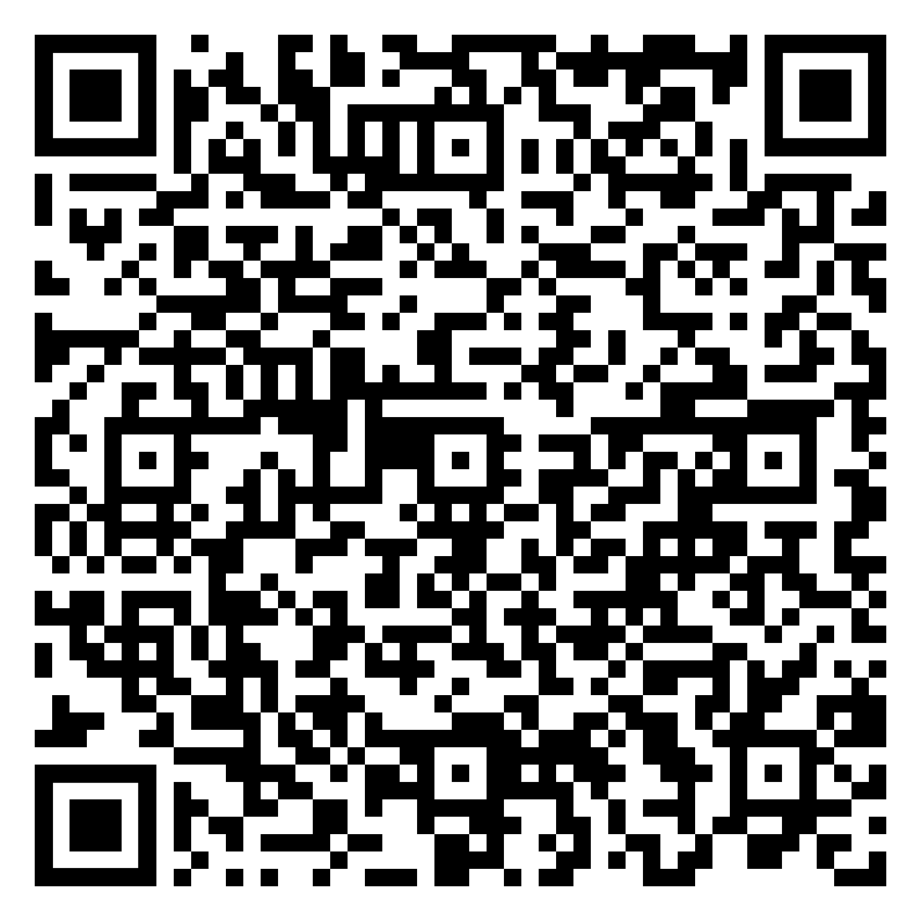
How to apply
TEACHER INPUT
Applications close at midday on Friday 16 October
1
2
3
4
Application
Governor discussion
Student ballot
Appointment
Submit the online nomination form. Deadline: midday, Friday 16 October.
Please scan to access the application form
An informal conversation about your interest, the commitment and what you'd bring. 2–5 November. It is not an interview and does not need preparing for like one.
Held where more candidates apply than there are places. 9–23 November.
Committee recommendation on 24 November; formal Board appointment on 14 December.
Deadline
midday, Fri 16 Oct
Strong applications are specific: why improving the College matters to you, an example of leadership or influence — running a shoot crew, organising a Film Club night, leading a revision group — and evidence you will prepare and turn up.
Questions? Belle Howard, Director of Governance — Belle.Howard@escg.ac.uk
Module D — Students' Voice & Student Rep Elections | A Level / Year 2 — Media, Film, Photography and Digital
Notes:
SLIDE 10 — HOW TO APPLY
Mode: TEACHER INPUT | Time: 4 mins
The deadline — midday, Friday 16 October — is the operative fact. Everything else on this deck can be revisited; this cannot.
Note for A-level Y2: students not continuing at ESCG next year are not eligible to serve a full term (slide 7). Redirect them to the Rep role rather than letting them draft an application that can't proceed.

Slide 11


PROUD VALUE
Encourage Unity
You've seen what collective voice looks like when it works — and when it doesn't. Year 2 is when you can drive it. One person short of darkroom time is bad luck. A whole set short of it is evidence.
Experience is only useful if you share it. Year 1 can't know how coursework and exam preparation collide in the spring. You do.
A rep you helped choose is a rep who'll listen when you tell them what matters — like past-paper access before mocks, or edit time before a hand-in.
The group that engages this year sets the standard for the one that comes after. Next year's Year 2 inherit whatever routine you leave behind.
Notes:
SLIDE 8 — ENCOURAGE UNITY (PROUD) Mode: TEACHER INPUT | Time: 5 mins The returner-specific angle: 'You've been here long enough to know what collective voice looks like when it's working. That's exactly why this year is different — you're not starting from scratch.' The three cards are talking points — use whichever lands: • Experience card: returners carry institutional knowledge that new students can't have. That knowledge is only useful if it's shared — through the rep, through the survey, through talking to the group. • Rep card: you chose your rep today. That means they're accountable to you. Use that. • Legacy card: slightly different register — this group's engagement (or disengagement) shapes what the next cohort walks into. Worth saying once, briefly, without making it heavy. Bridge: 'Right — election time.'

Slide 12
Election time
ACTIVITY
Nominations · Pitches · Vote · Confirm — 30–35 minutes
1
2
3
4
Nominations
Candidate pitches
The vote
Confirm & register
Any student may put themselves forward. Two seats are elected today: subject rep, and GCSE English/maths rep. Allow 2 minutes.
Each nominee takes 1 minute. You've seen this done — say what you'd do differently. “I'd get the coursework and mock dates published together at the start of term.” Tutor keeps time.
Group decides the fairest method. Tutor facilitates agreement then runs the vote. Anonymous slips work well where students are split across teaching groups.
Announce both results. Add the subject rep and the English/maths rep to the central Student Rep Register before this session closes.
Must complete
before session ends
MANDATORY: Student Rep elections must be completed and the rep confirmed no later than the end of Week 2 of the academic year.
Module D — Students' Voice & Student Rep Elections | A Level / Year 2 — Media, Film, Photography and Digital
Notes:
SLIDE 9 — ELECTION ACTIVITY
Mode: ACTIVITY | Time: 30–35 mins
Returner-specific framing for the pitches: 'You've seen a rep do this job. You know what good looks like — and what doesn't. If you're standing, say what you'd actually do. If you're voting, hold candidates to that.'
STAGE 1 — NOMINATIONS: Returners are generally less hesitant to put themselves forward than first-years. Allow 2 minutes but don't be surprised if it moves faster. If nobody stands initially: 'Who in this room do you trust to take your feedback forward?' — redirect to character, not volunteering.
STAGE 2 — PITCHES: The pitch slide copy says 'you've seen this done — say what you'd do differently.' That's the returner register. Credit experience without making it a condition: students who didn't engage much last year can still stand.
STAGE 3 — VOTE: Returners often prefer to move quickly. Let them set the pace on voting method — they've done it before.
STAGE 4 — CONFIRM AND REGISTER: Must happen before session closes. Add to central Student Rep Register: name, group, campus.
MANDATORY: Elections must be completed by end of Week 2. This session is Week 3. Do not leave this unfinished. If nobody stands, flag immediately to Head of Department and Student Enrichment Co-ordinator.
NOTE — run nominations once and elect both seats: subject rep first, then the GCSE English/maths rep. A student may hold both only if nobody else stands. Both names go on the central register before the session closes.

Slide 13
Before you go
ACTIVITY
One thing to take from today
Choose one — write it down, or tell the person next to you:
1
I'll use my vote
2
I'll brief my rep
I'll vote in any college elections or surveys this year — and I'll actually think about who or what I'm voting for. Like which brief or final piece the group takes on.
I'll tell my Student Rep something specific from last year that still needs fixing — like feedback arriving too late in the coursework cycle to use — and brief my English/maths rep on that class too.
3
I'll use what I know
4
I'll tell someone about a barrier
I'll stand, advise, or pass on what I've learned — to a rep, a Year 1 about to start their first production unit, or through a Governor application by 16 October.
There's something affecting my experience here that I haven't said yet. I'll tell my subject teacher, my personal tutor, my rep or my Student Enrichment Co-ordinator this week.
Module D — Students' Voice & Student Rep Elections | A Level / Year 2 — Media, Film, Photography and Digital
Notes:
SLIDE 10 — COMMITMENT CARD Mode: ACTIVITY | Time: 5 mins Key returner differences from Core: Option 2 — 'I'll brief my rep': upgraded from Core's 'I'll talk to my rep.' The returner version names a specific, accountable action: something from last year that still needs fixing, with a follow-up check. This credits their experience and sets a higher bar than the passive version. Option 3 — 'I'll use what I know': the most distinctively returner option. Three routes — stand (for Rep today or Governor in November), advise (a friend, a new student, this year's rep), or pass on knowledge. Works for both L3Y2 (Governor route is available) and A-level Y2 (Governor route may not be, but the advising and passing-on routes still are). Option 4 — safeguarding disclosure: identical to Core. Standard language, same structural purpose. Keep a note of who chooses this and check in individually before the week is out. Running it: 2 minutes to choose, then 2–3 students share. Acknowledge without evaluating.

Slide 14
Your Students' Voice team
Your Student Rep
Student Enrichment Co-ordinators
Elected today — confirmed on the central register.
They represent this group at Student Council.
Your English/maths rep represents this group in that class.
Eastbourne: Chelsey King
Lewes: Tessa Echalaz
Station Plaza & Ore Valley: Paige Baker-Carroll
Your first Student Council meeting:
Eastbourne
Lewes
Station Plaza
Ore Valley & ATIC
Wed 11 Nov 2026
Tue 10 Nov 2026
Thu 12 Nov 2026
Tue 10 Nov 2026
Next steps:
Rep training: Wednesday 14 October — newly elected reps must attend (all campuses)
Induction Survey opens: Monday 3 November — three minutes, worth doing
Student Governor applications: close midday, Friday 16 October — speak to your Student Enrichment Co-ordinator if you're continuing at ESCG
English/maths rep: elected today too — same training, same Council meetings
Notes:
SLIDE 11 — CLOSE Mode: SESSION MAP | Time: 5 mins Name the rep aloud — 'Your Student Rep is [name], elected just now.' Make it concrete. Rep training note: even returners who have been reps before attend the 14 October training as newly elected reps. Say this explicitly — some will assume it doesn't apply to them. Governor note: the 'continuing at ESCG' qualifier is in the bullet for A-level Y2 visibility. Don't labour it — just let it land. Close briskly. Returners don't need a warm wind-down — they need clear next steps and to get on with their day.

Slide 15
DO NOT DISPLAY TO STUDENTS — TEACHER APPENDIX
Module D — Students' Voice & Student Rep Elections | A Level / L3 Year 2 — Media, Film, Photography and Digital | 100 minutes | Group 1: Settling In & Belonging
Running order
Teaching this group — L3 Year 2 / A-level Year 2
0–10 min Slide 3 Check-in: two questions, returner frame
10–20 min Slide 4 Students' Voice — what makes it work
20–30 min Slide 5 Ways to get involved (Year 2 lens)
30–40 min Slide 6 The Rep role + familiarity-as-risk
40–45 min Slide 7 The Governor role + eligibility note
45–57 min Slides 8–10 Governor: the Board, the commitment, how to apply
57–62 min Slide 11 Encourage Unity (PROUD)
62–94 min Slide 12 Election: subject rep + English/maths rep
94–99 min Slide 13 Commitment card
99–102 min Slide 14 Close + next steps
Returners have institutional knowledge first-years lack. The risk is that familiarity breeds disengagement — they've 'done' induction. Name this directly and use their experience as the argument for standing, not just participating.
L3Y2: 'last lap' register. Don't fumble what you've built. Governor route is open.
A-level Y2: UCAS pressure is real and imminent. Don't minimise it. The rep commitment is manageable alongside applications if the student is organised — say so honestly. Governor route may not be available (see slide 7). This room mixes A Level Media, Film and Photography with Level 3 Extended Diploma and T Level students. Most met heavier written and exam demand than they expected. Several carry one high-stakes assessment a rep can raise in November but not fix in May. Inferred — please review.
Pre-flight checklist
Safeguarding alert
□ Know your campus's Student Council 1 date (slide 6 table)
□ Access to the central Student Rep Register
□ Know which students are A-level Y2 (Governor eligibility flag, slide 7)
□ Student Enrichment Co-ordinator contacts:
Eastbourne: Chelsey King
Lewes: Tessa Echalaz
Station Plaza & Ore Valley: Paige Baker-Carroll
□ Rep training noted: Wednesday 14 October (all campuses)
□ English/maths rep seat confirmed — both names on the register
Highest-risk surfaces: check-in discussion (slide 3) and commitment card option 4 (slide 13).
A-level Y2 UCAS pressure may mask wellbeing concerns — watch for signs of stress, anxiety, or isolation framed as 'just busy.' These students are less likely to disclose than to simply disengage.
Standard procedure: listen calmly, do not promise confidentiality, do not investigate. Report same day via ESCG safeguarding procedure. Module F covers full detail. Two department surfaces: content guidance before a challenging screening is a safeguarding step, and self-directed studio work gives distress somewhere to hide. Inferred — please review.
Notes:
Teacher appendix — not for student display.
NOTE — teacher appendix. This deck has been personalised for A Level and Level 3 Year 2 Media, Film, Photography and Digital, and every adaptation marker has been completed. Still needs your local detail: campus and teaching group, GCSE English and maths class times and teachers, the Governor application link, who holds the Student Rep Register for your area, and one real local example of a change students asked for. Two rep seats are filled in this session: subject rep and GCSE English/maths rep.
NOTE — the Governor block (slides 8–10) adds roughly 12 minutes. Protect the election: it is mandatory by end of Week 2.

